Slide 1



NOV, 2023
FILM BLOG IDEA
BY CHINH
AND
TRUONG
By Chinh
and Truong

Slide 2

Overview
1
Team members
2
What is this application?
3
Requirements
4
Wireframes and details description

Slide 3

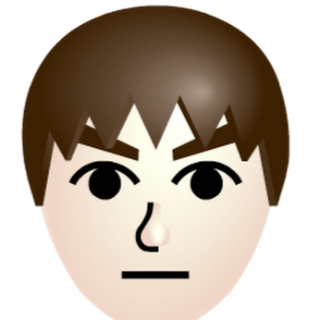

Team Members
Chinh and Truong are two members in charge of this project.
Chinh - Developer
Truong - Developer

Slide 4





Purpose
1
What is this application for?
What film made you go through
emotions like this?
The Godfather? I mean a lot of movies
Can you write down some of your thoughts?
Sure?
Also how and where to share?
My film blog forum
Kay

Slide 5

So we can sum up the purpose of the blog
A place for people to express their thought and feeling for a movie, and other users can see whether that movie is worth watching not. Also it’s a place for people to gossip about directors and actors,...

Slide 6
Requirements
Functional requirements and non-functional requirements
Functional
Non-functional
Registration and Authorization
Post management (create, read, edit and delete posts)
Query posts(filter and sort and search)
Edit user information
View user profile
Responsive UI
User Interaction(Commenting, viewing others profiles,...)
Lazy loading
Short maintenance time
Compatible for many browser
Security (Encrypted User Credentials)
Easy to use

Slide 7

How we divide our work
Chinh - Developer
Truong - Developer
Rich text Editor (Create, Edit Post)
Query posts(Search, Filter, Sort)
CRUD functions for post(Create, Edit, Delete, Update) posts
User interaction (Commenting, viewing profiles)
Edit users profile
Designing and Initialising layout
Most of non-functional features (lazy loading,..)
Authenticating and authorisation(Log in, Log Out, Sign up)
Blog overview
Viewing post

Slide 8

Wireframes and Detail Description

Slide 9
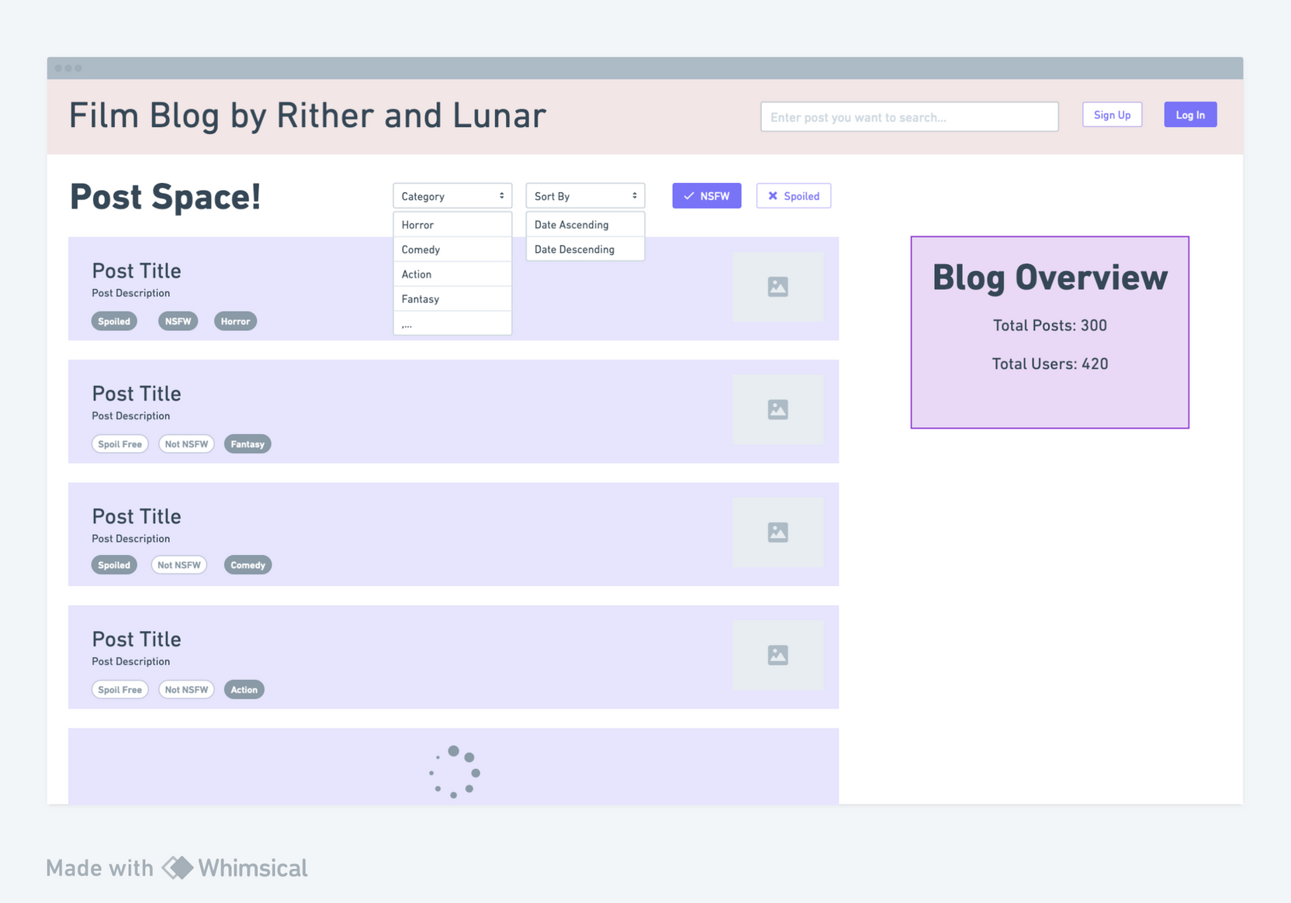
Index page (not logged in)
Query (Search, Sort, Filter by category, NSFW, Spoiled tags)
Blog posts
loading which are fetched from the database,
visitor
Log in and sign up buttons take user to log in/sign up page
Unauthorised users can view posts

Slide 10
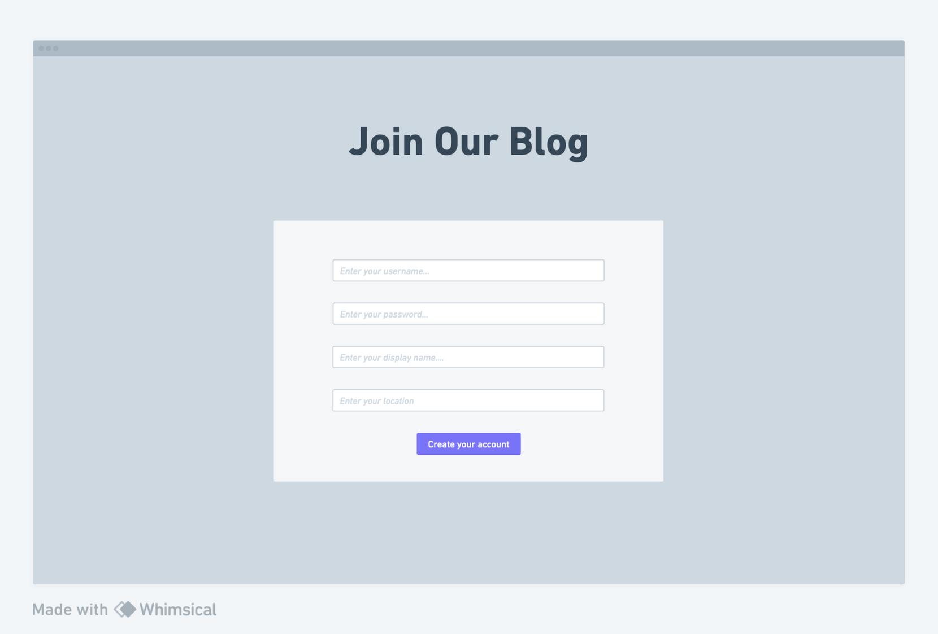
Sign Up Page
Features:
User can create an account by entering username, password, display name and location.
User must be a member of the blog to be authorized to post on the blog and interact.

Slide 11
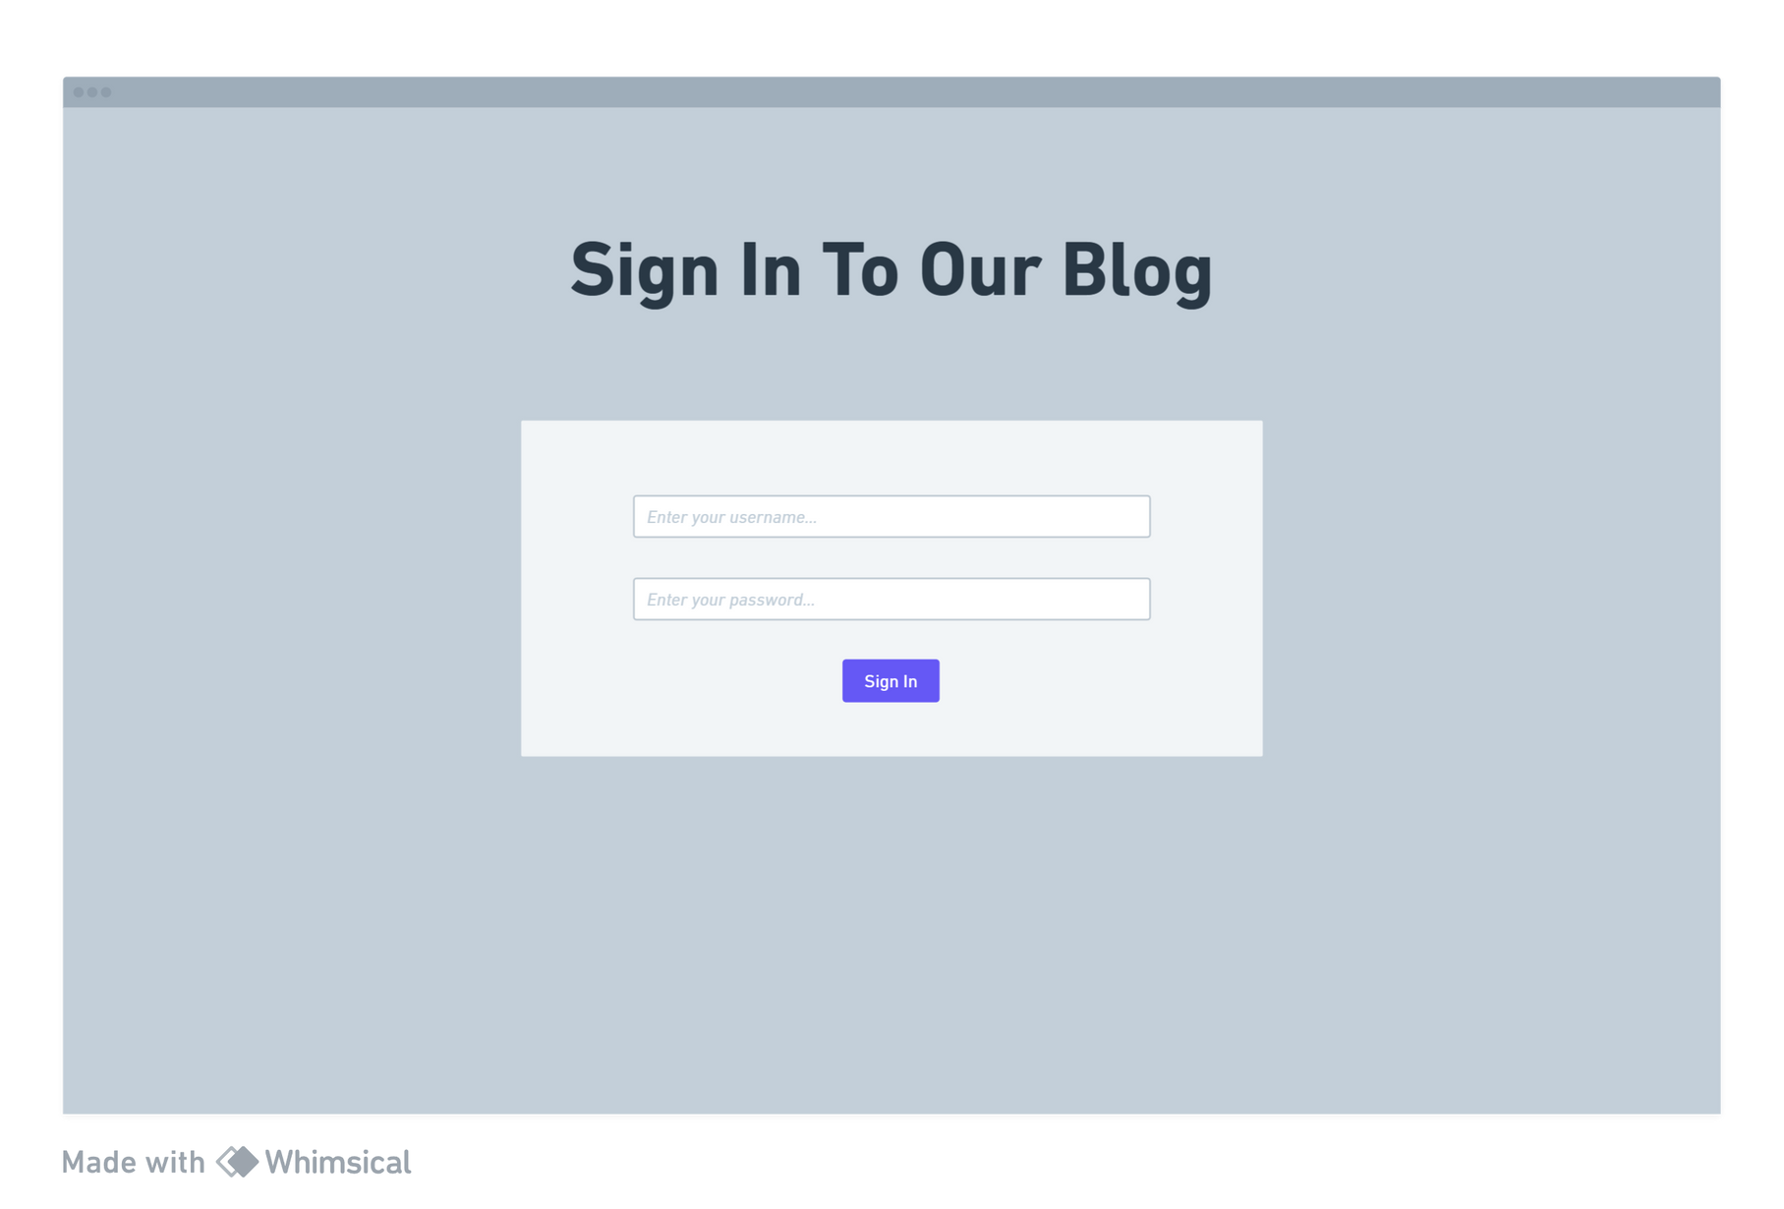
Log in page
Features:
User can login if they already had an account.
Login requires an username and password
Login credentials must be authenticated

Slide 12
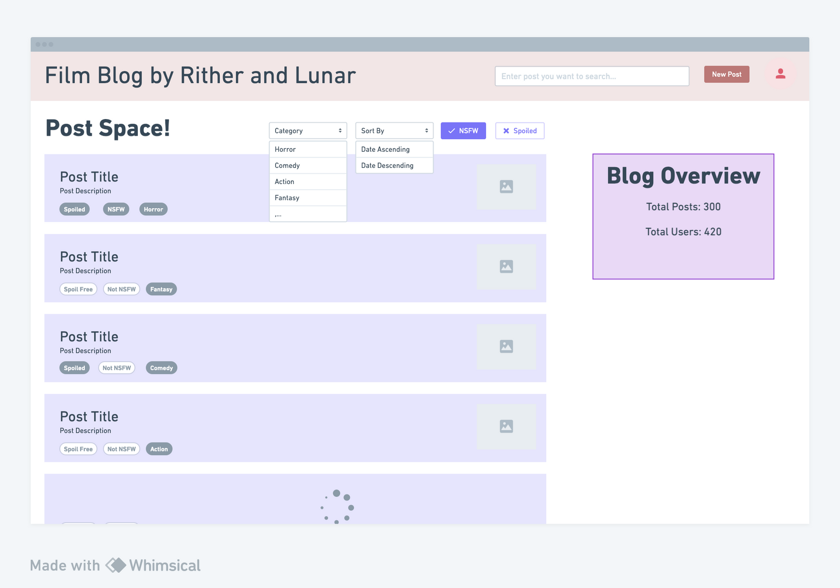
Index after logged in (after authorized)
Authenticated users can
Create post
Visit their own profile
Blog overview to show total number of posts, users of the blog
Lazy loading post to avoid loading all posts at once -> increase performance

Slide 13
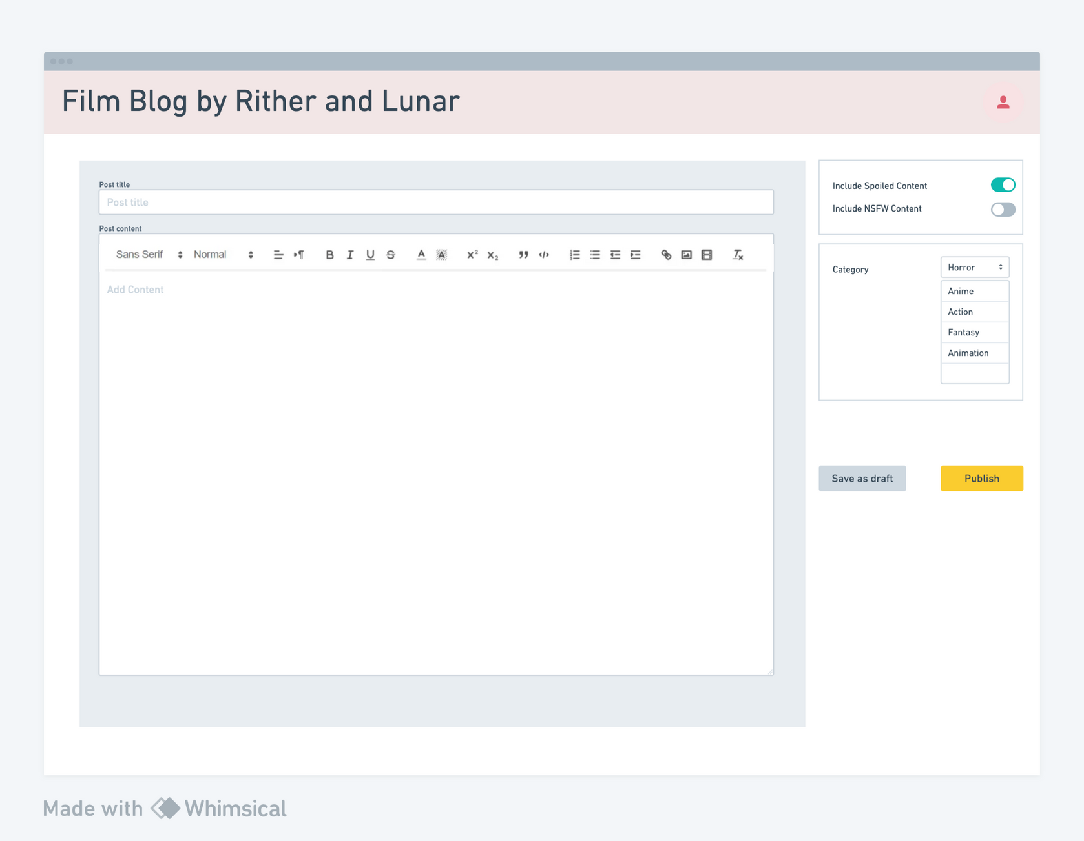
Post create page
Users can create new post when they click on the new post button on the navbar.
User can use the rich text editor to upload images, links, add category, NSFW, spoiler warning,...

Slide 14


When users click on the avatar picture, they will be redirected to user pages which are
Post overview page
Account overview page
Edit information page

Slide 15
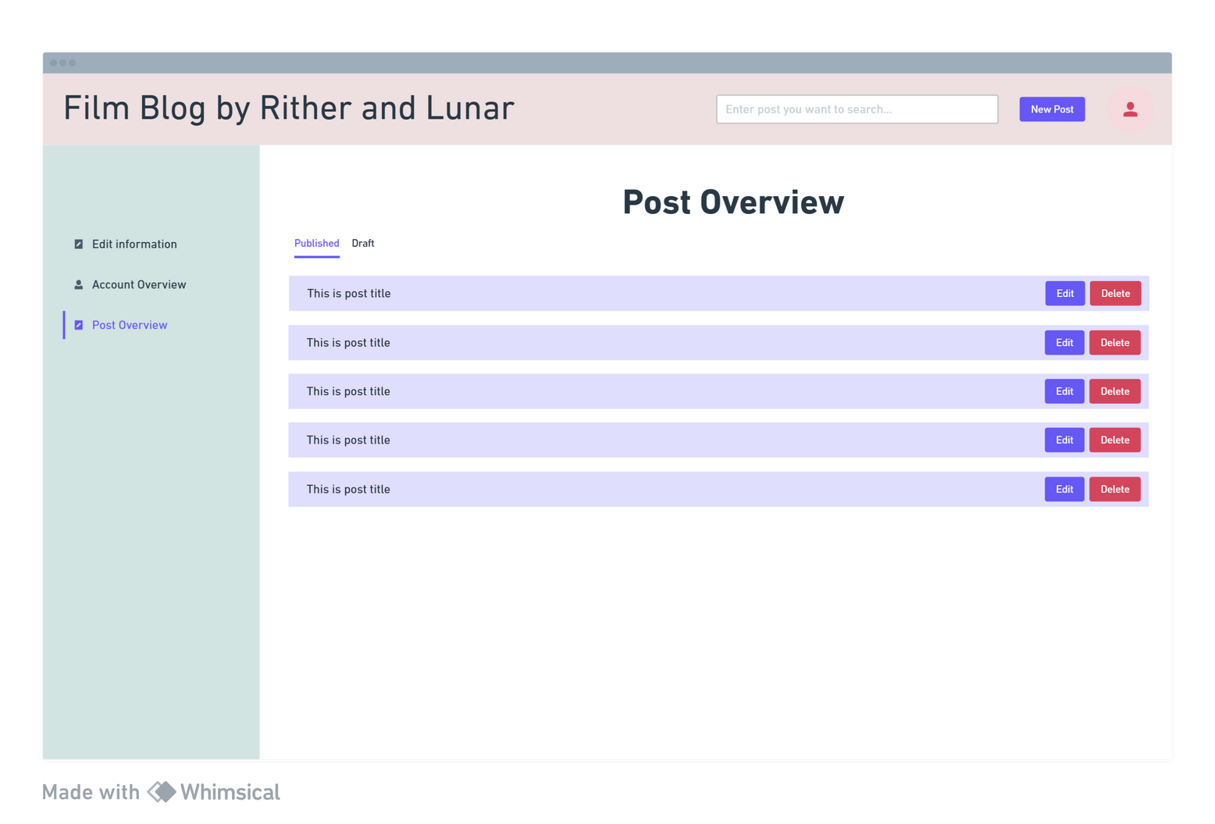

Post overview page
User can see all of their posts (draft /published)
User can view every individual post by clicking on the post in the published post column.
Every post row includes its post title in the left and quick functional button combo in the right
Click on “delete” will show up a modal to confirm their action
Click on “edit” button will open post editor page
CRUD (Create, Read, Update, Delete)

Slide 16
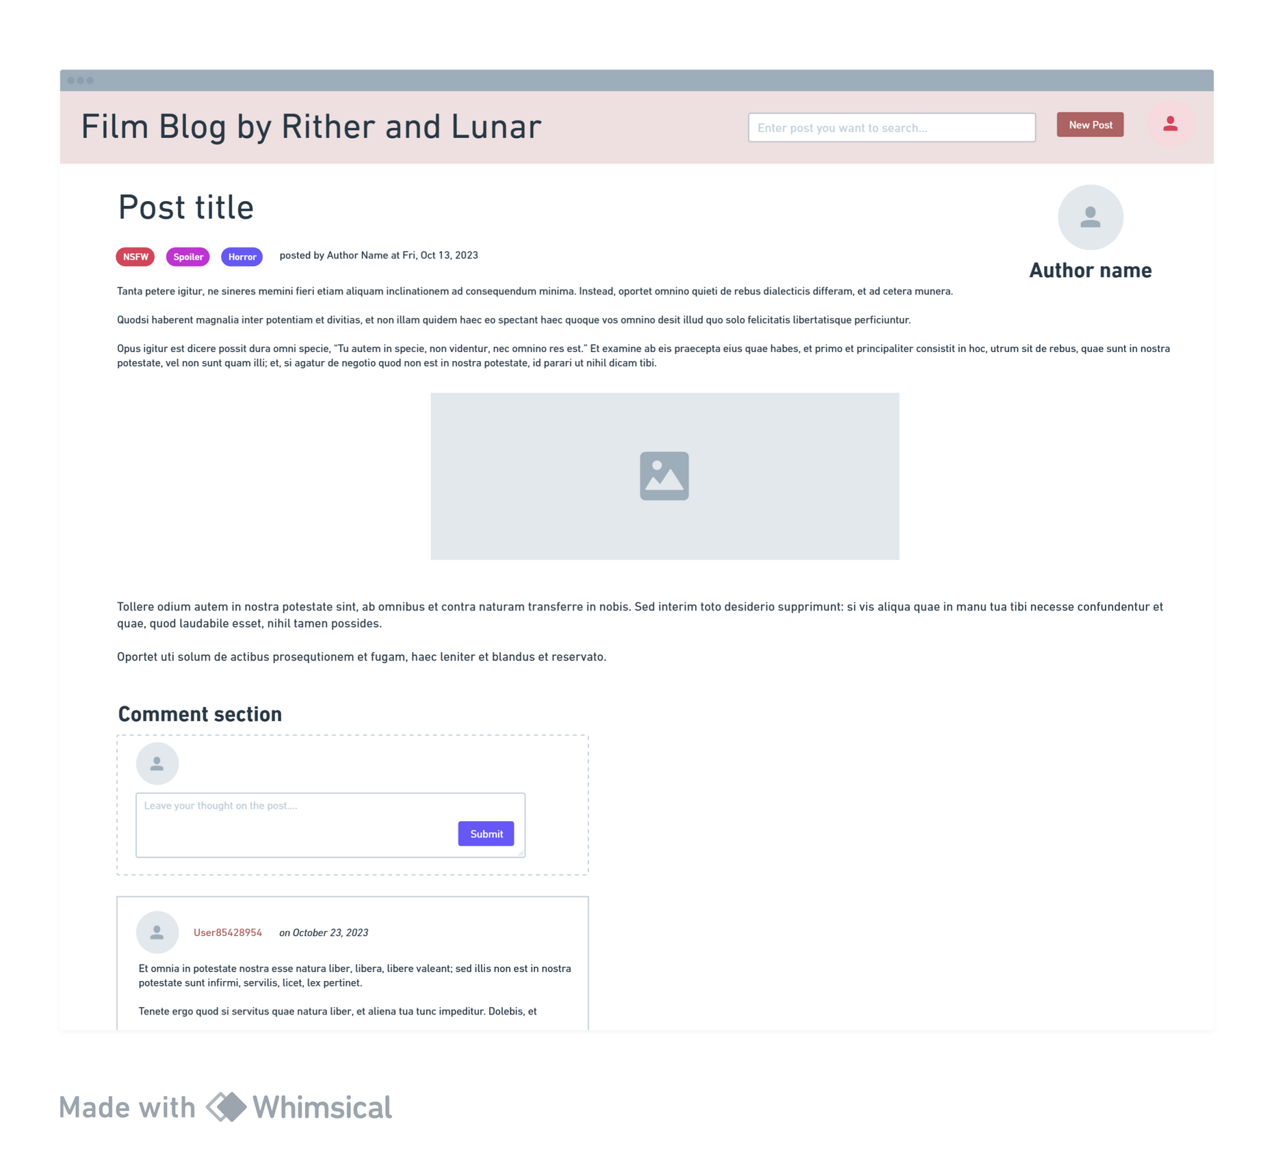

Post page
Features
Includes post title, created date, content rating, author name and post content
Authorized users (users that already logged in) can leave their comments in the comment section below.

Slide 17
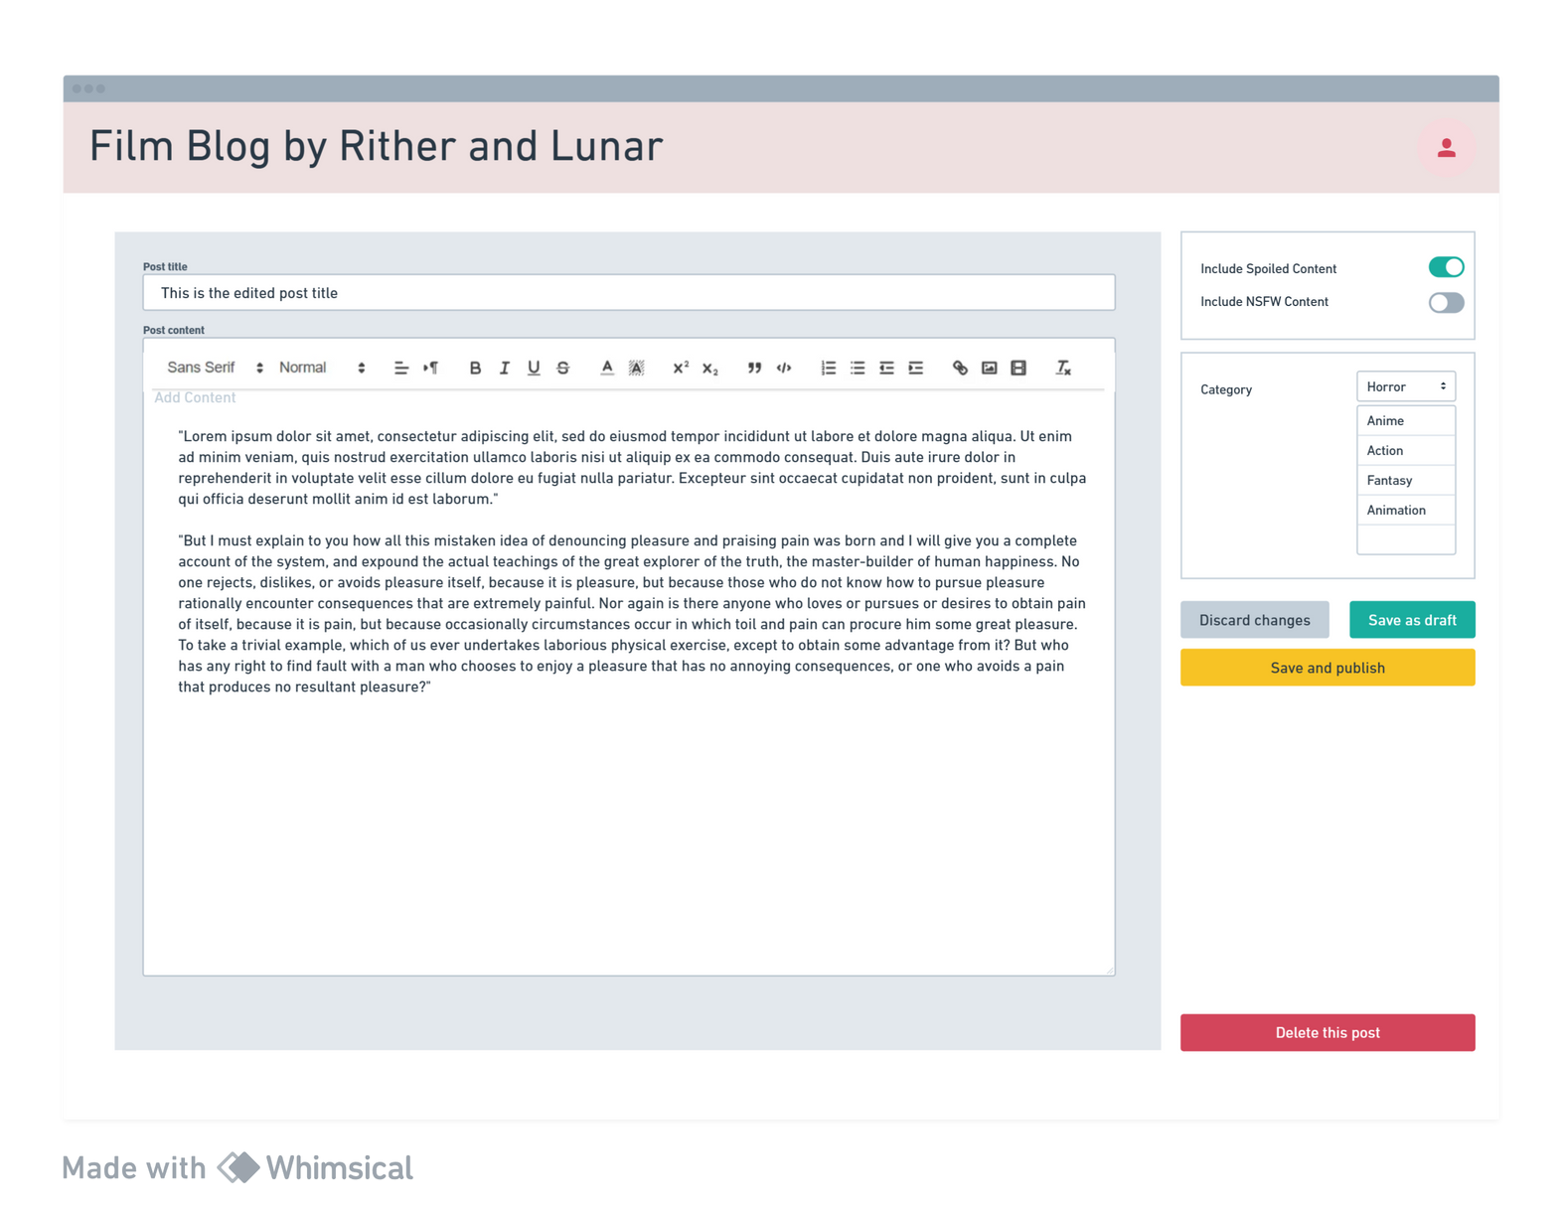

Post editor page
Features:
Includes a title text field; a rich text editor that allows users to add image and modify text styles; options for content rating, category, add spoiler/nsfw warning.
Users can choose to save their post as a draft or publish/delete it.

Slide 18
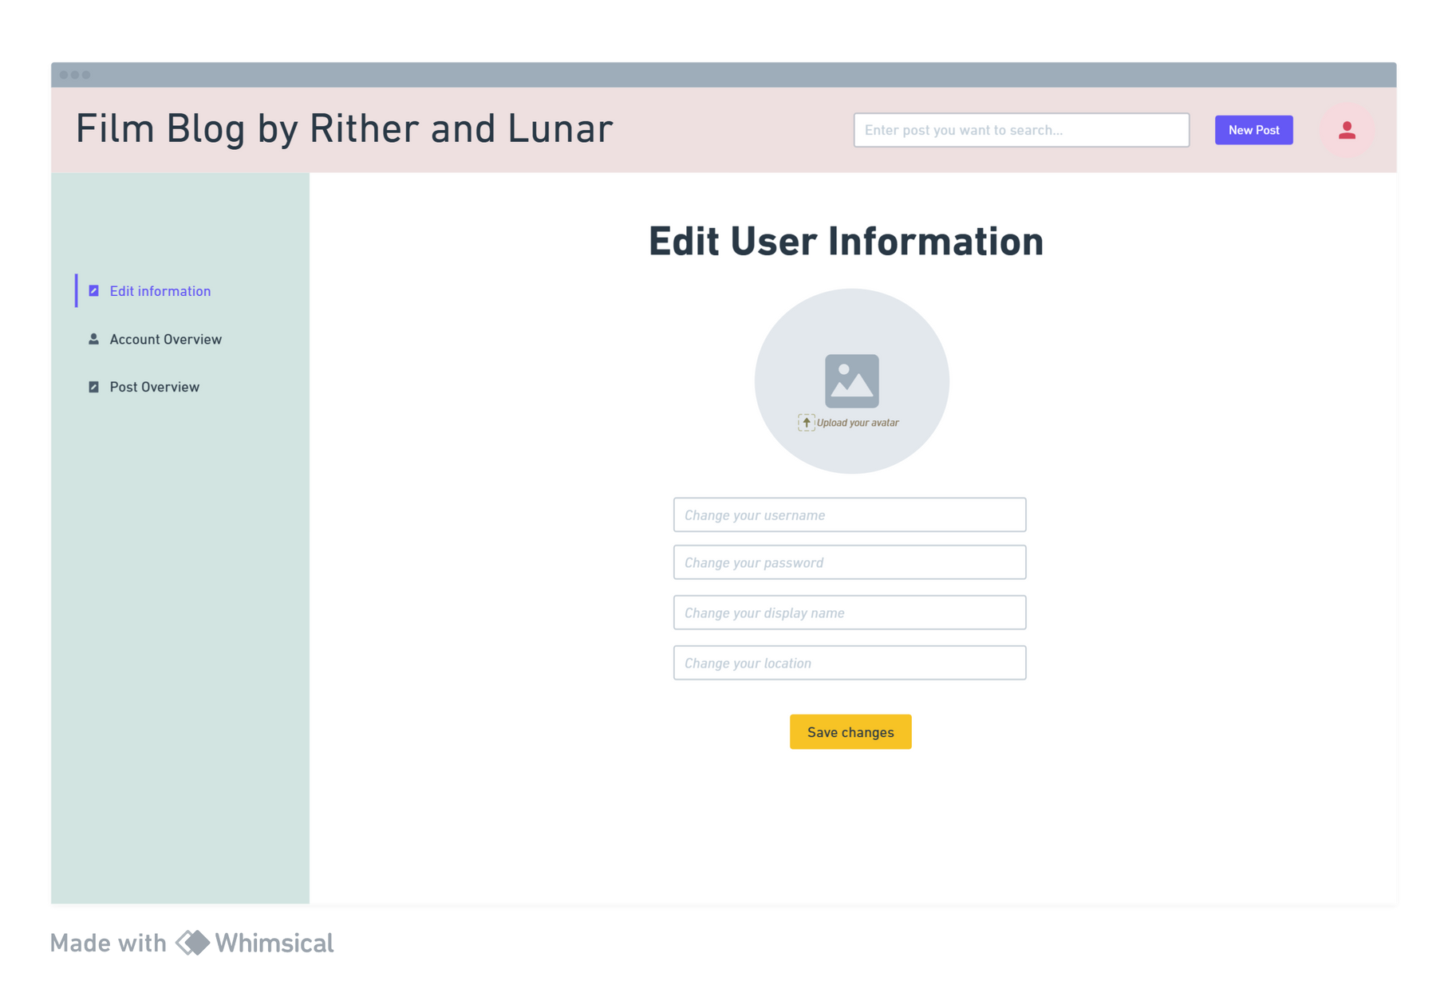
Edit user information page
Authorized users can edit their own public information (display name, avatar, location), login credentials and upload their own profile picture.
Any change will not be made until they click on “save changes” button.

Slide 19
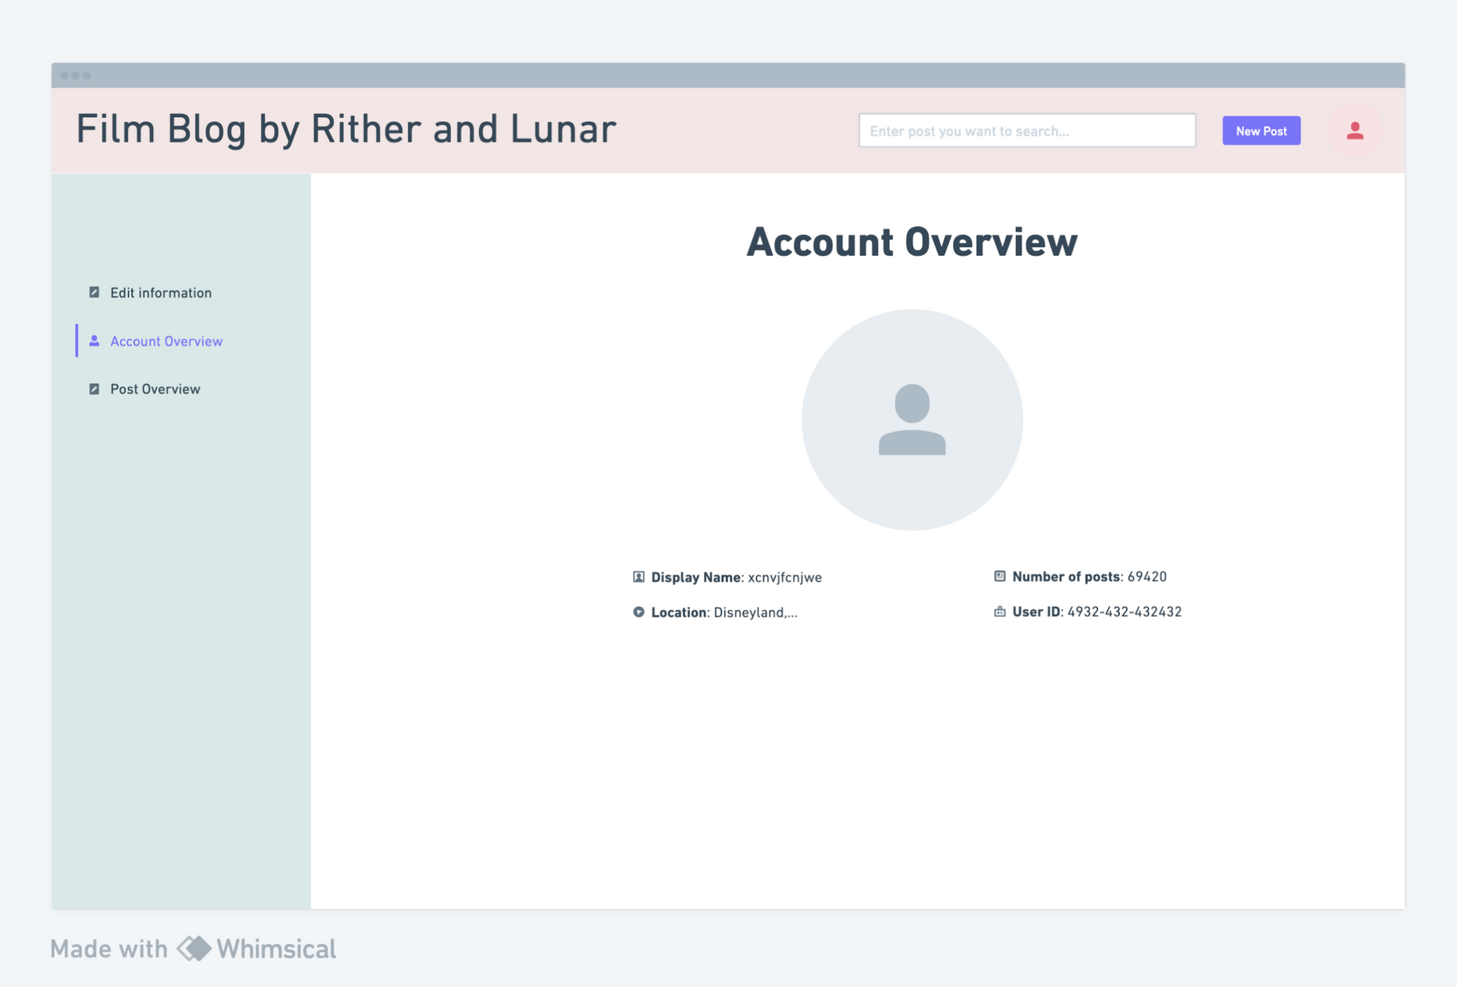
Account Overview Page
Users can view their display name, number of posts, location, user id,...

Slide 20

Check out the wireframe link: https://whimsical.com/blogging-8FgJkBJx2VHsuLZ98KUnr2

